Slide 1
Classification
Andrea Murphy and Josh Quigley

Slide 2
WHAT IS CLASSIFICATION
Notes:
Classification is the process of predicting the class of given data points. Classes are sometimes called as targets/ labels or categories. Classification predictive modeling is the task of approximating a mapping function (f) from input variables (X) to discrete output variables (y).

Slide 3
Exploratory Analysis
The Dataset
The dataset was obtained at:
https://archive.ics.uci.edu/ml/datasets/Adult
The data is made up of adult incomes (>50K and <=50K)
Extracted from the 1994 Census database
Description:
Classes: 2 ( ‘>50K’ and ‘<=50K’)
Attributes (Columns): 15
Instances (Rows): 32560

Slide 4
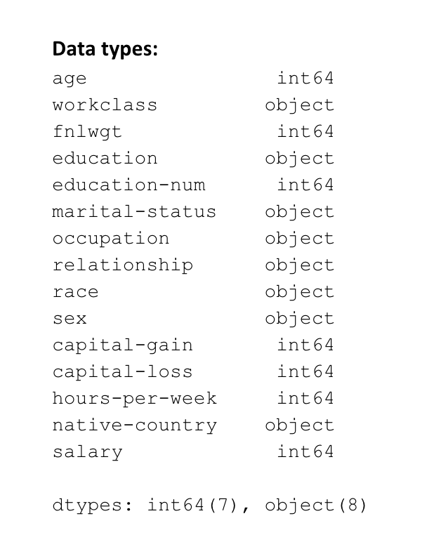
Data types
Exploratory Analysis

Slide 5
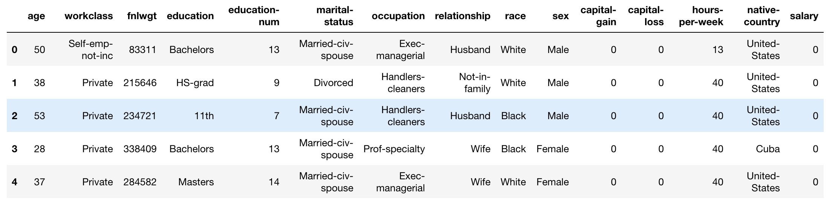
Exploratory Analysis
Attribute Information

Slide 6
Project
Prediction task is to determine what features impact whether a person makes over 50K a year

Slide 7
Exploratory Analysis
Of models

Slide 8
Exploratory Analysis
Of models

Slide 9
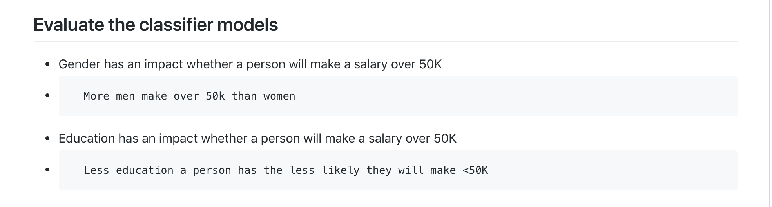

Slide 10


Slide 11
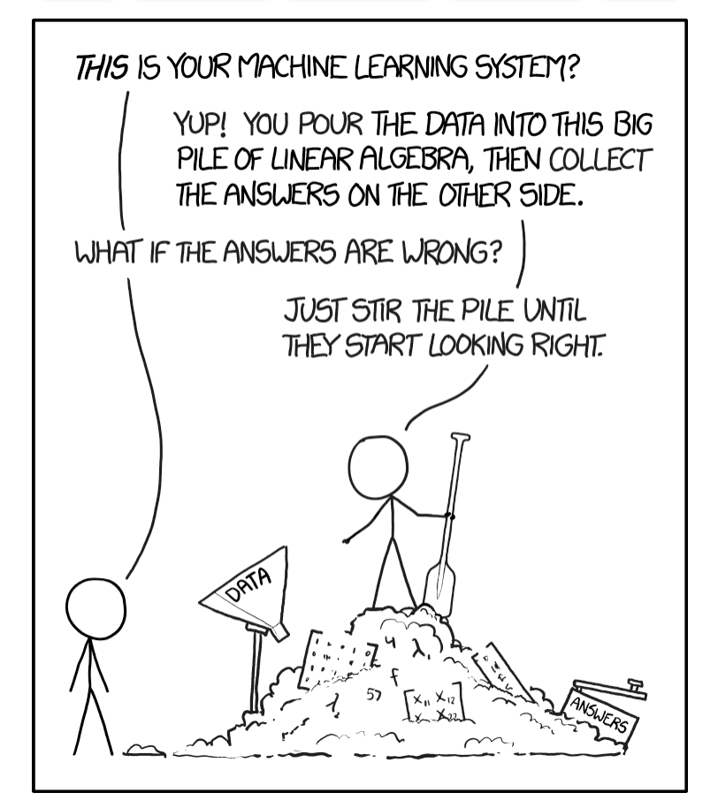
QUESTIONS

